Slide 1
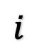
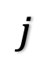
$$i$$
$$j$$

Slide 3
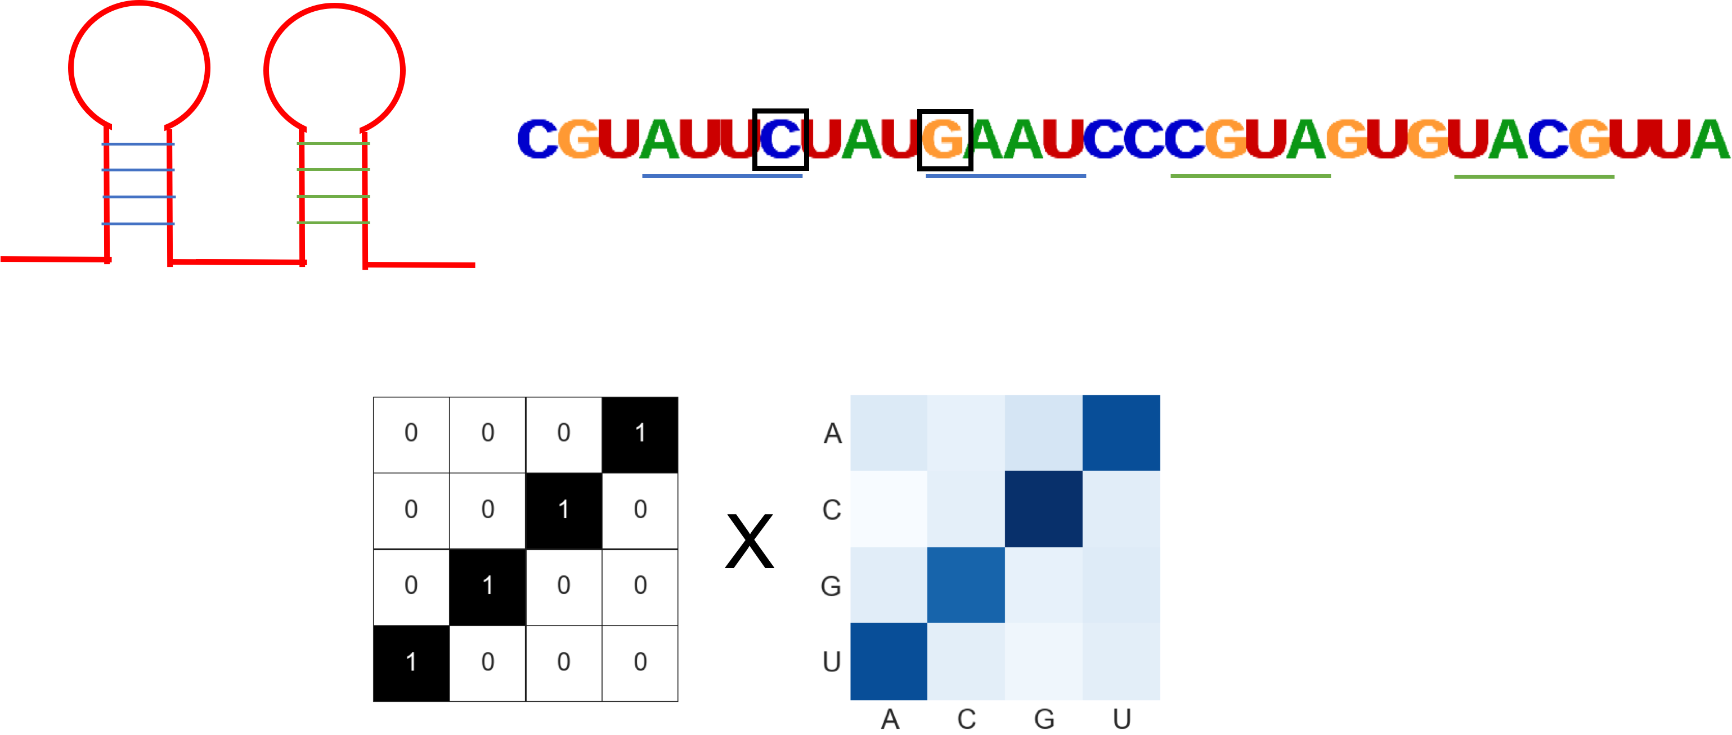
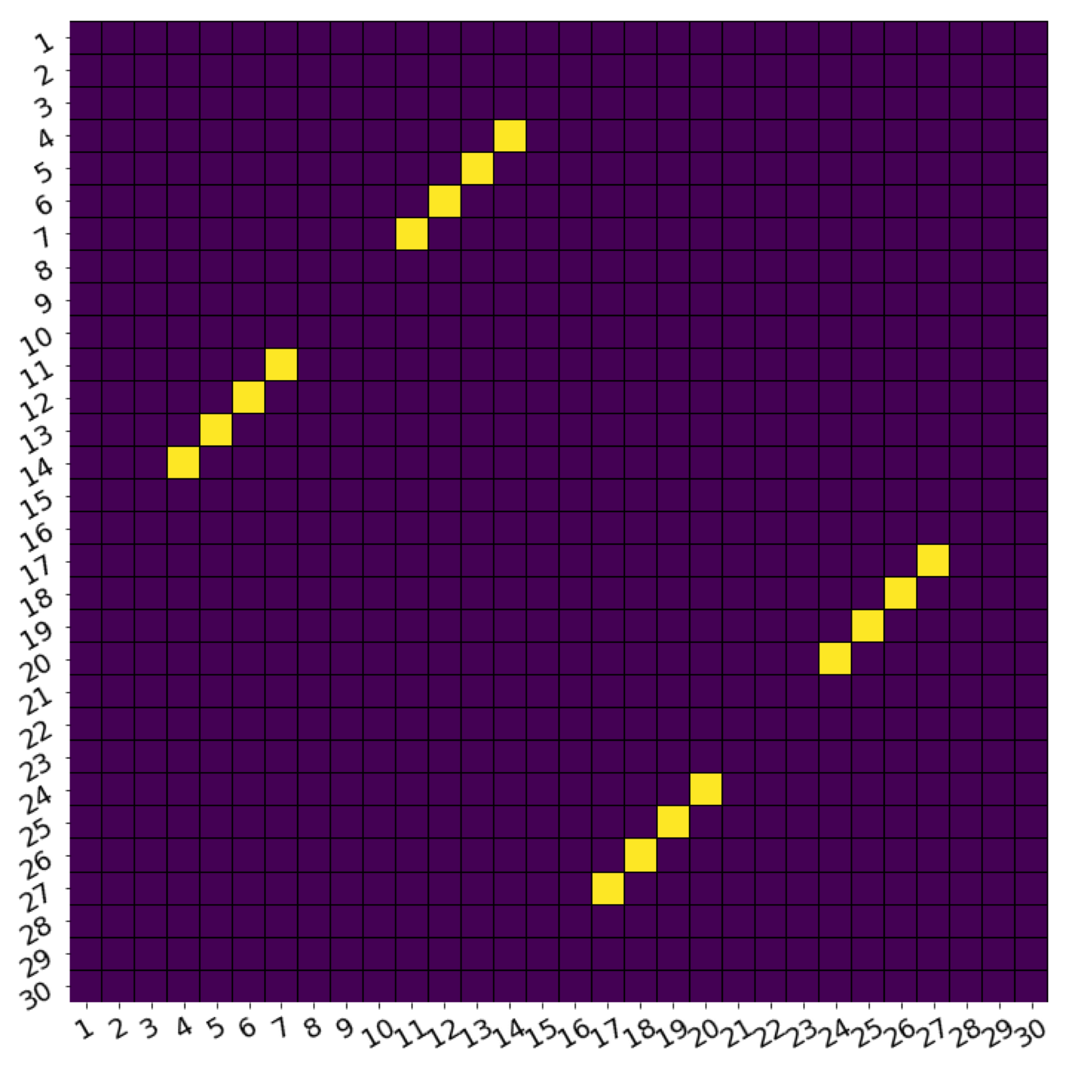
∑

Slide 4
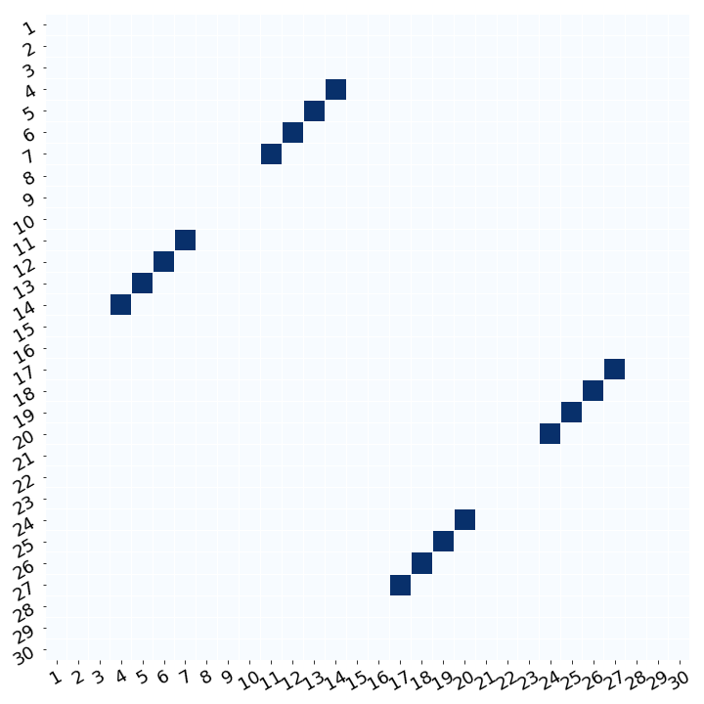
∑
Notes:
5.29

Slide 5
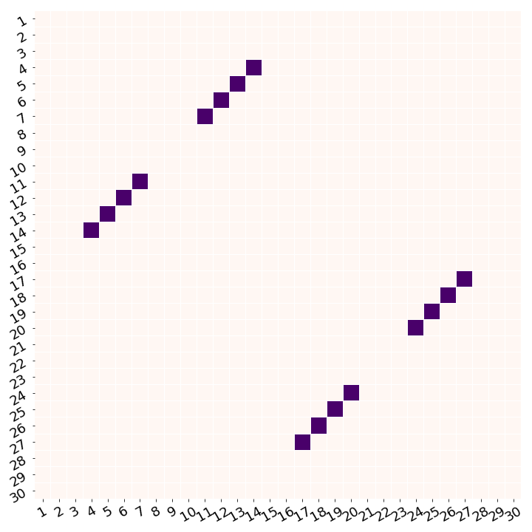
Notes:
5.29

Slide 6

(i)
(iii)
(ii)
BPfilter
Score Matrix
(iv)
(v)
WCplot
Notes:
5.29

Slide 7
Figure 4: The schematic for second order in silico mutagenesis (SoM). (i) For a given sequence of length L, we perform saturated pairwise mutagenesis, mutating every possible pair of sites to all pairs of nucleotides. (ii) For a given pair of sites, we produce 15 mutant sequences in addition to the WT and get the scores of each sequence from the NN. The off diagonal of the score matrix corresponds to the complementary nucleotide pairings for watson crick base pairs. If these sites are base paired, we’d expect the NN to output high scores for the sequences with complementary mutations that maintain watson crick base pairs. (iii) To reduce the dimensionality of each score matrix, we employ a BPfilter. (iv) We perform element-wise multiplication and sum the values to retrieve a single SoM score. (v) We denoise the SoM scores by averaging SoM scores across multiple sequences and perform an APC correction. The SoM scores are then plotted according to the positions in the original sequence that were mutated with the colour showing the gradient of SoM scores with darker blue showing a higher SoM score.

Slide 8
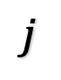
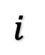
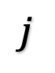
$$i$$
$$j$$
12
18
25
30
1
4
5
6
11
13
17
24
14
19
20
26
7
27
∑
High score
$$i$$
Low score
$$j$$
Notes:
5.29

